Slide 1

MAYA YOUR IDEATION TOOL
BY:
IYLIA YASMIN BINTI SHAMSUL
NUR AINA FARISHA BT MUHMAD JAFFAR
NUR ANEES BINTI KAMARUDDIN
KHALED GHANDURI

Slide 2
ABSTRACT
MAYA system is an ideation tool that is created to help HILTI employees work remotely. It is a reliable and flexible system that facilitates HILTI employees to share their ideas, thoughts, and projects.
This system helps in improving work efficiency and productivity even though employees cannot communicate directly.
It is developed using java language and Service-Oriented Architecture(SOA). The system integrates with third-party application to help employees organize their work using one application which is the MAYA system.

Slide 3
INTRODUCTION
Remote collaborative work has been redefined and becomes the ideal way of working after the world has been shocked with the Covid-19 storm. Even though this was not very common in most industries before early of the year 2020, remote working has become a significant option compared to the traditional style of working in the office that everyone is familiar and comfortable with. It is during this time of the year the issues of remote collaborative work start to appear and is taken more seriously as it affects both the organization and the employees.

Slide 4
PROBLEM STATEMENT
Inefficient communication between workers in a team involved in developing new or current projects remotely
Affect work performance and productivity
Face difficulties in coping with iterative changes and processes that occur for products or services
Unable to cater the iterative changes in an effective manner
Difficulty of interaction between different mediums
Communicating work or changes involving different medium is challenging
Lead to a disorganized work
Improper management information related to projects

Slide 5
PURPOSE
This system is designed to allow the possibility to collaborate with other experts of HILTI from across the country despite the differences of background, knowledge or even timezone.
To allow workers who work remotely to be able to follow and keep updated with the workflow.
To increase flexibility among HILTI workers which allow them to work at their own pace and time by using one standardized platform.

Slide 6
SCOPE
Developing new and secure remote work and collaboration solutions
Overcoming the problems of remote work and collaboration

Slide 7
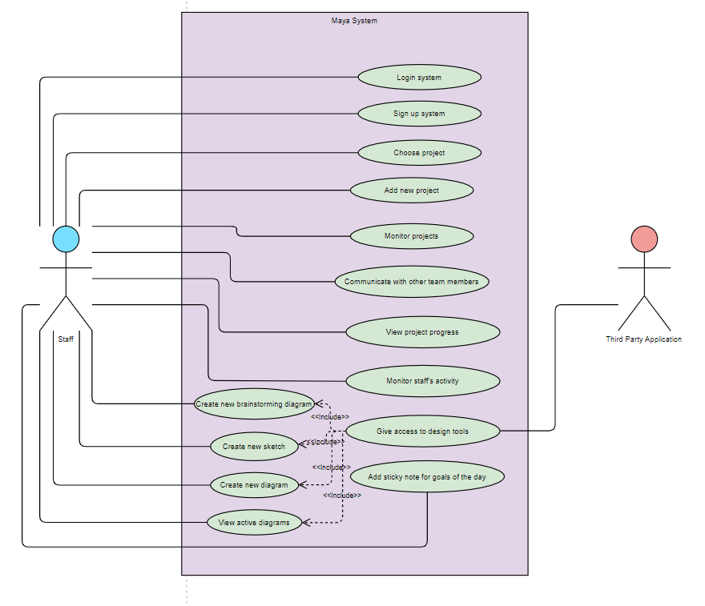
USE CASES DIAGRAM

Slide 8
SYSTEM ARCHITECTURE
Language: Java - Object-Oriented language.
The benefits of Object-Oriented Language (OOP) are:
Encapsulation of data
Reduce code redundancy by reusability
Easy to be upgraded

Slide 9
SYSTEM ARCHITECTURE
Architecture: Service Oriented Architecture(SOA)
Service Oriented Architecture(SOA) is a software development model based on a contract between a consumer, which is the client and a provider, which is the server through a communication protocol over a network.
The benefits of SOA are as follows:
Promotes reusability of codes
Supports maintainability
Reduces Cost

Slide 10
SYSTEM ARCHITECTURE
Technology: Cloud computing
One of the concepts of cloud computing is Software-as-a-Service (SaaS); a Web-based software services model that provides underlying and infrastructure support for various applications including the completion of service initialization and the maintenance of the operating environment for instance data backup services.
The advantages of SaaS are as follows:
Support for accessibility
Reliable data backups
Reduce cost for the company

Slide 11
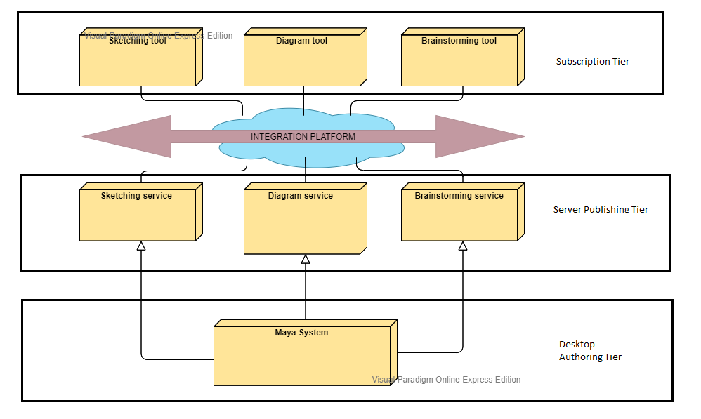
DEPLOYMENT DIAGRAM

Slide 12
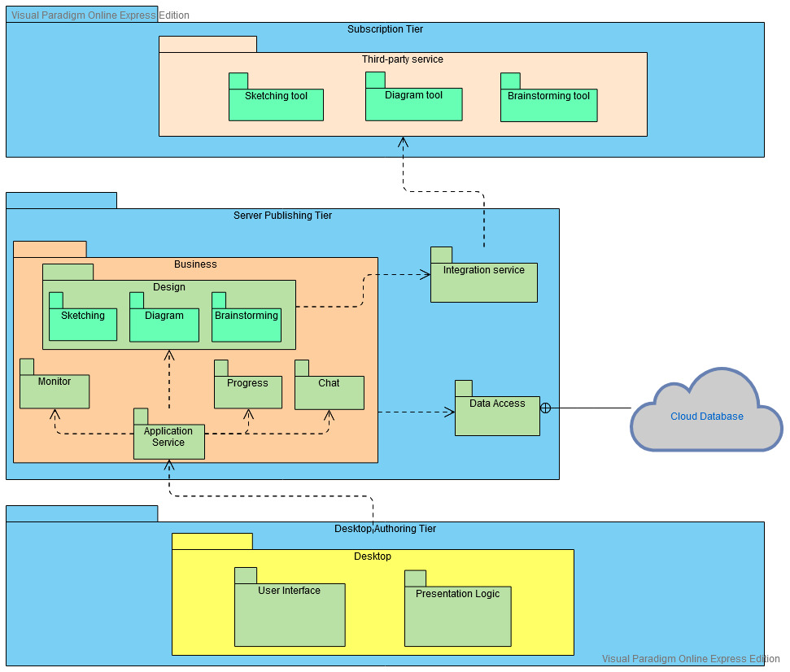
PACKAGE DIAGRAM

Slide 13
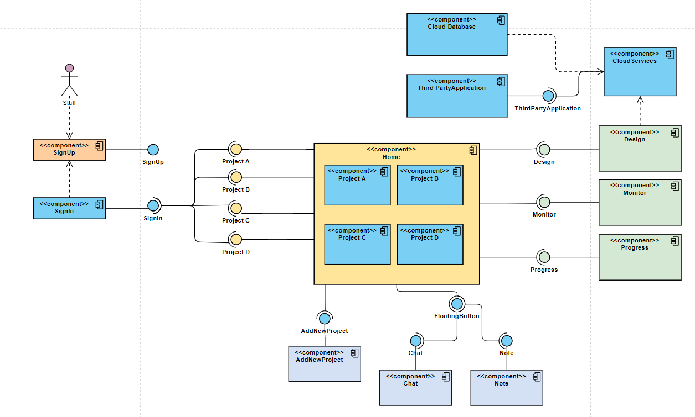
COMPONENT DIAGRAM

Slide 14
BENEFIT OF THE PROJECT TO HILTI
The system acts as the standardised platform or hub for all HILTI staffs to generate creative ideas, communicate ideas and changes, perform design activities for HILTI tools and services, monitor progress of other team members and track history of progress of the staff.
The system shall increase the productivity between HILTI staffs as it allows staff to work at their own pace anywhere and everywhere with easier access to communicate efficiently. It promotes working flexibility that would further encourage the staff to be more motivated, less stressful and create a happier working environment despite having to work from home.
The system shall demolish the perception of working for HILTI staffs and the company should be based solely inside the office and promote Work-From-Anywhere(WFA) instead to further evolve according to the everchanging Industrial Revolution (IR) 4.0.
The system will help to cut the cost of the HILTI company in the long run as it provides multiple services, promotes effective communication and increases collaboration among staffs under just one standardised platform, which is the MAYA system.

Slide 15
USER
INTERFACE

Slide 16
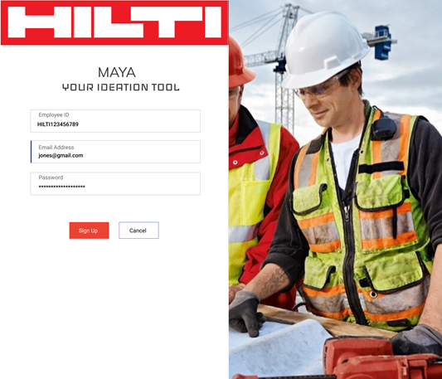
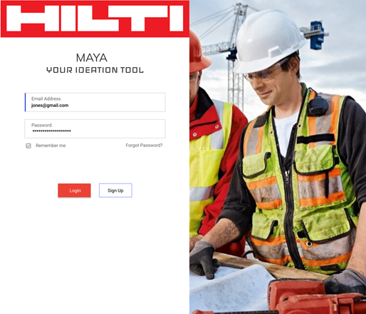
SIGN UP
SIGN IN

Slide 17
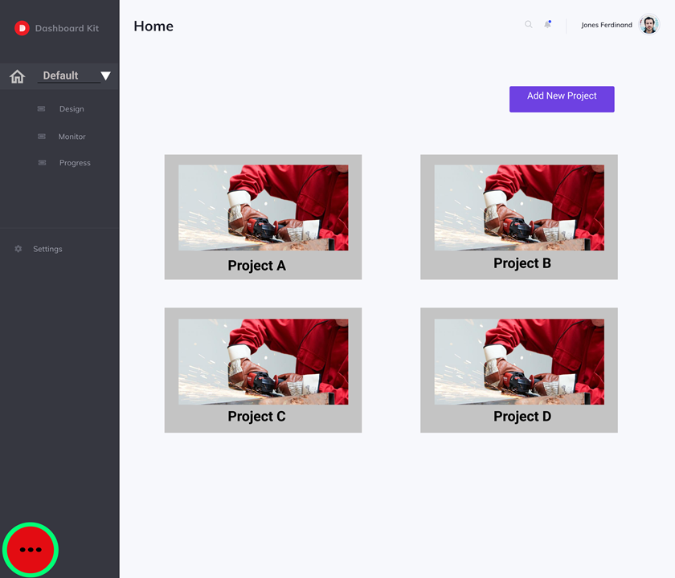
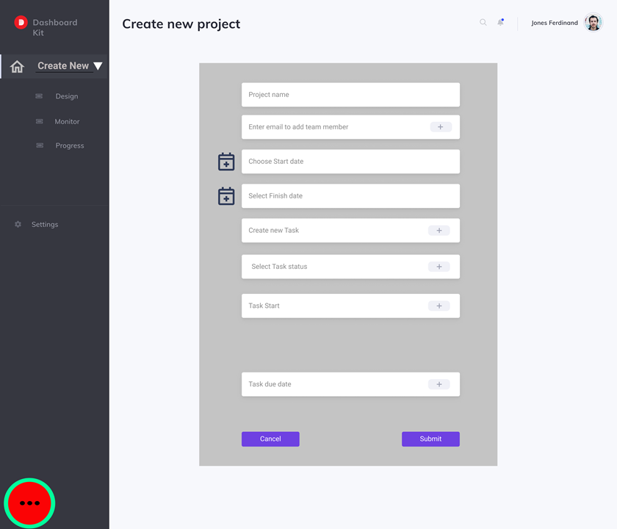


Slide 18
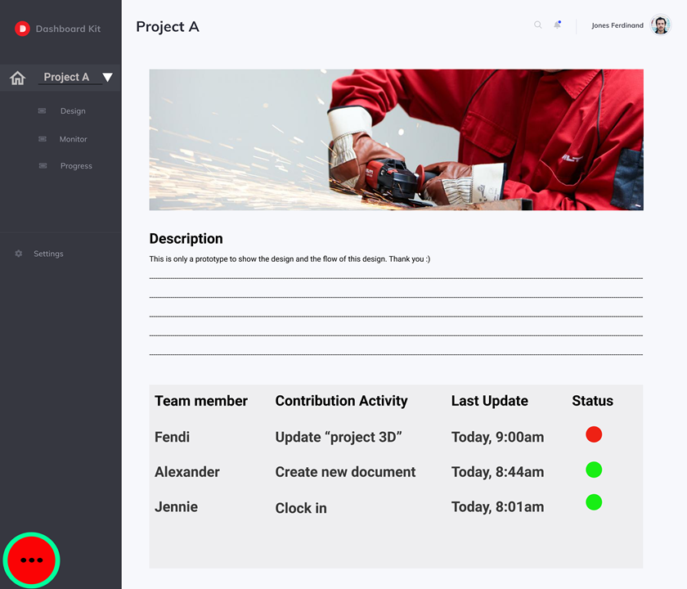

Slide 19
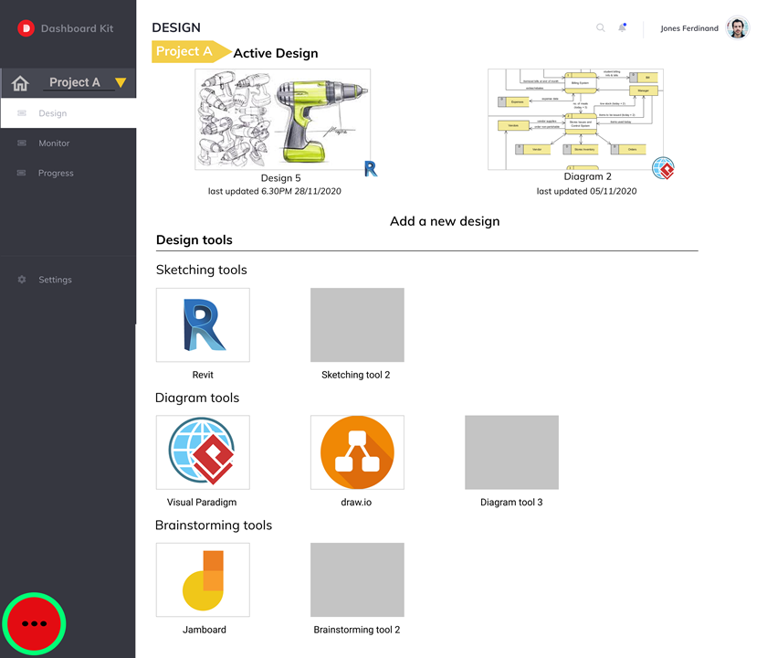
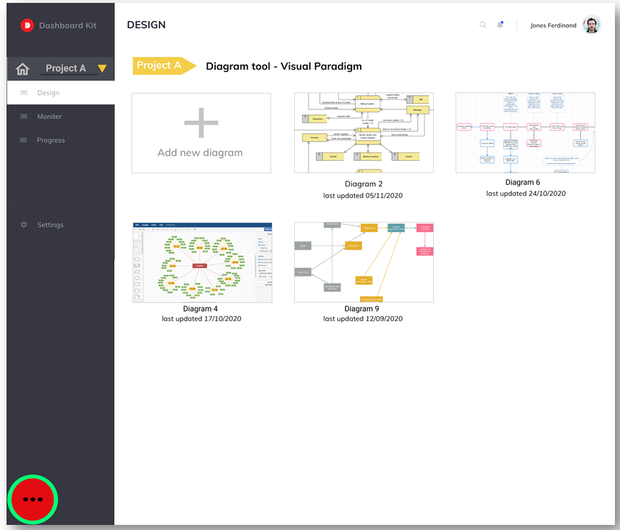

Slide 20
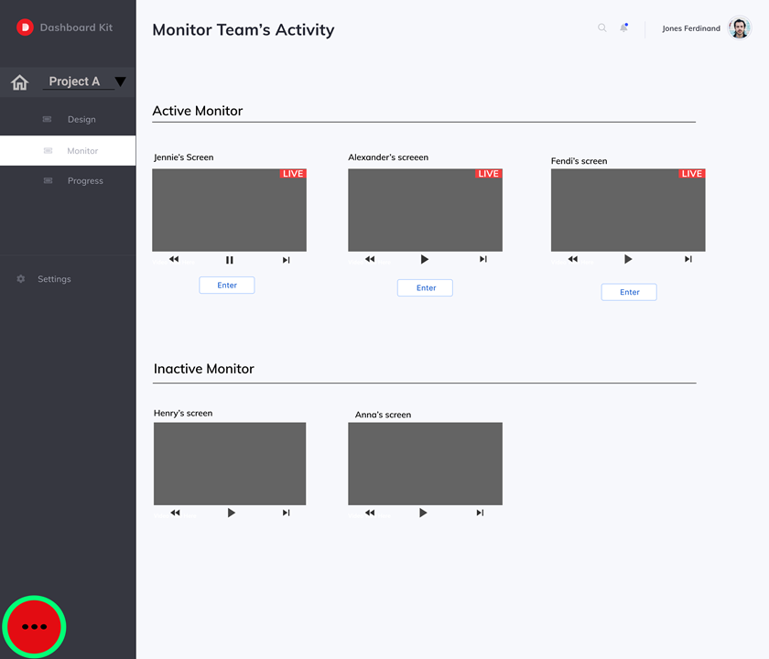

Slide 21
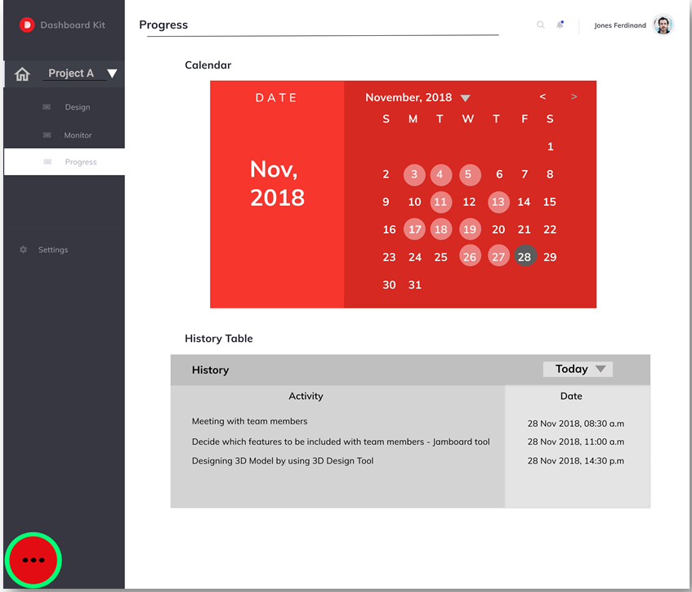
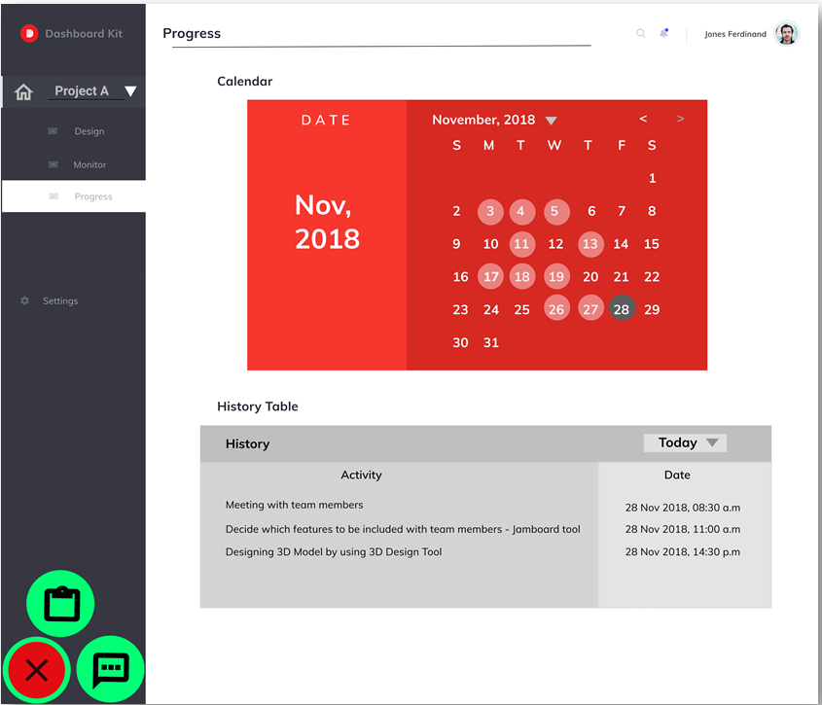

Slide 22
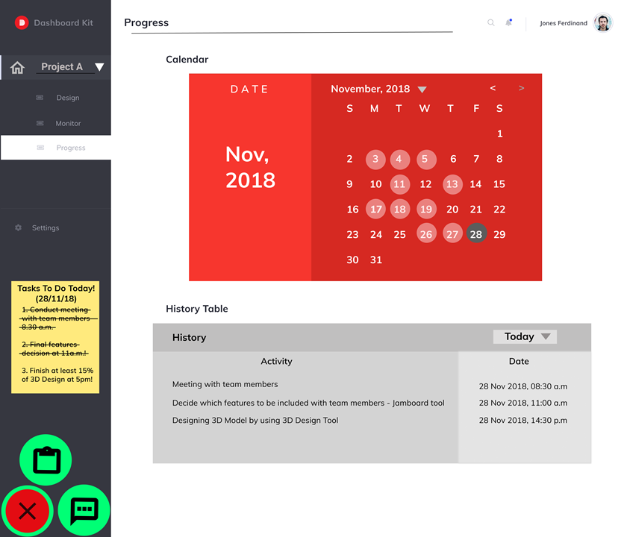
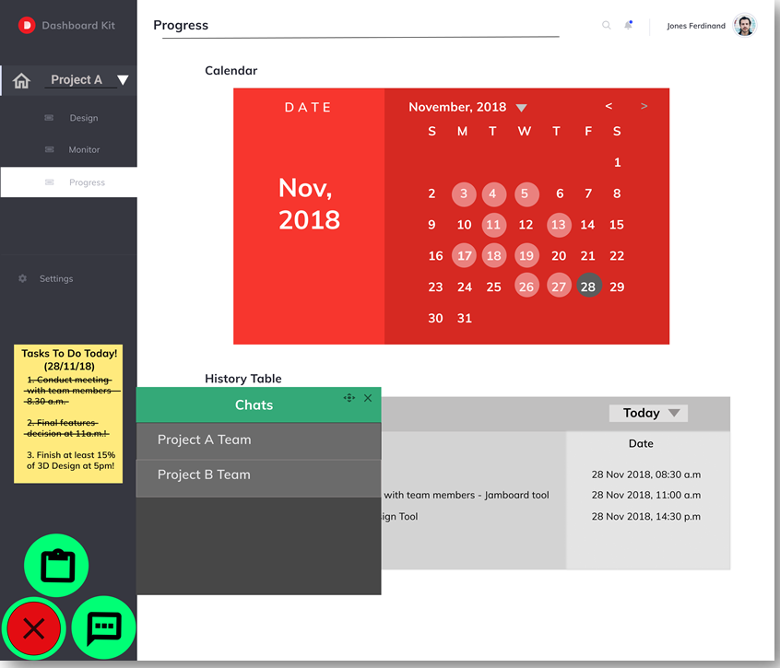

Slide 23
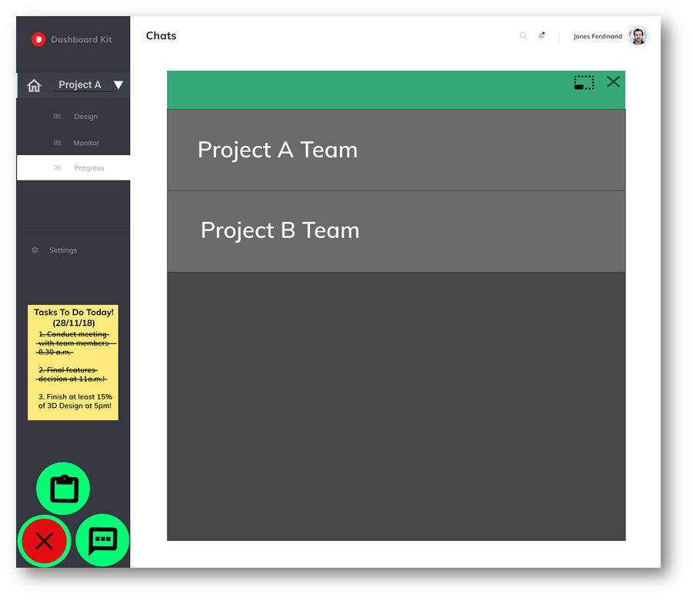
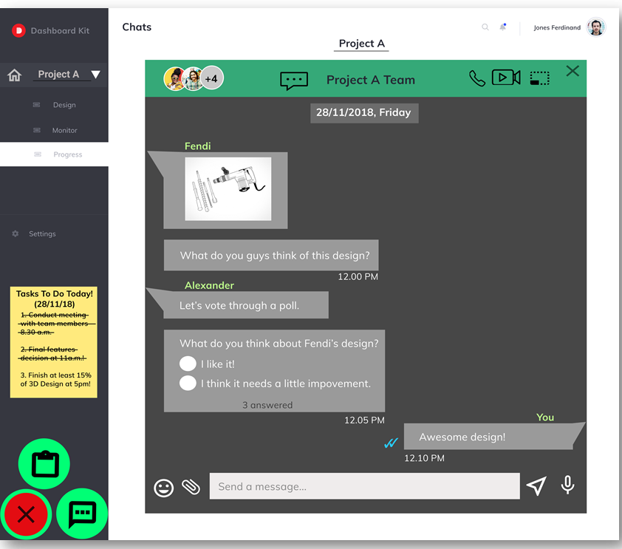

Slide 24
CONCLUSION
MAYA system is a versatile system that is created to cater the needs of HILTI staffs to accomplish a successful remote working environment with an effective collaboration among the staffs. MAYA system delivers all the functionalities needed by the HILTI staffs to work remotely by providing an effective medium for communication, ideation and collaboration with a reliable SOA architecture that integrates with cloud computing SaaS to produce a faster and compatible data and process integration with the third-party applications. MAYA system would be a great addition to the HILTI company and can be further developed into a greater system that brings benefits to HILTI in heterogeneous ways.

